Slide 1
An Introduction to Cryptocurrency (Bitcoin) Security
@IsaiahSarju and @RevDarragh
of @RevisSolution
April 5, 2018

Slide 2
Thanks!
Evolve Security
1871
TEKsystems

Slide 3
Goals
Primer on core security principles affecting cryptocurrency
Technical options for increasing/reducing security
Reflect on your risk profile
Synthesize – based on your risk, how could you improve?
Spark discussion – now and later

Slide 4
Full Disclosure: Our Assumptions
The blockchain system works technically
It will continue to work in relevant time horizon
People use Bitcoin (other cryptos)
Bitcoin has some value
To transfer/store value, people use tools
People want to protect their claims to value
(Some) people want to steal value from others

Slide 5
Full Disclosure: Our Opinions
We’re not evangelists!
“Blockchain is the Future”
“Bitcoin is better than Ether”
Well, maybe we are, but for security!
Everyone should understand security basics
Everyone should take basic steps against common threats
They’re not hard or expensive to implement

Slide 6
Overview
Review Cryptography
Cryptography applied to distributed ledgers
Threat modeling-ish
Private key protections
Live demonstration

Slide 7
Cryptography
“the art of writing or solving codes.”
Branch of mathematics
Making secrets secret
Three types of cryptographic algorithms
Symmetric
Asymmetric
Hashing
Digital Signatures
Notes:
Taking readable data (plaintext) turning it into unreadable data (cypher text)

Slide 8
Symmetric Cryptography
The keys to encrypt and decrypt are the same (symmetric)
Security depends on keeping shared secret secret
Notes:
Command gist:
You’ll need a linux virtual machine or install GPG on Mac for the following demos:
https://gist.github.com/isaiahsarju/94662929e2bfb3e626040f1a6f7dd9ea
Encoding: one to one mapping of data from one representation to a different representation. Ecoding isn’t meant to keep secrets. It’s meant to transform data so it can be transferred and then potentially converted back into it’s original form:
Encryption: Not meant to be recovered (e.g. hash) or is only recoverable with a key or passphrase (e.g. asymmetric/symmetric encryption)

Slide 9
Asymmetric Cryptography
Two separate and different keys (asymmetric)
Private Key
Public Key
Data encrypted with private key can only be decrypted with public key
Data encrypted with public key can only be decrypted with private key
Put public key into the world
Integral in SSL/TLS
Secrecy depends on keeping private key secret

Slide 10
Hashing
“A cryptographic hash function is a hash function which takes an input (or 'message') and returns a fixed-size alphanumeric string. The string is called the 'hash value', 'message digest', 'digital fingerprint', 'digest' or 'checksum’” – Wikipedia
One way hashing functions
Cryptographically secure hashing functions
Easy to compute
Hard to recover
Collisions are unlikely and unpredictable
Same message produces same hash
Altered message produces a new hash
Demo
Notes:
echo -n 'Hello World’ | shasum -a 256
A591a6d40bf420404a011733cfb7b190d62c65bf0bcda32b57b277d9ad9f146e
Like a smoothie. You can’t un-blend a smoothie. But you if you use the exact same proportions, same ingredients, and same hashing function (blender and settings) you’ll get the exact same smoothie. Even if you know the hashing function (blender and settings), but you don’t know the ingredients, you’ll have to make smoothie after smoothie after smoothie to figure out what ingredients/proportions were used.
This analogy breaks down when you talk about flavors. You can usually tell if banana or apple is in a smoothie. With a cryptographically secure hashing function the output provides no hints to what the input was.

Slide 11
Digital Signatures
Encryption(Hash, Private Key) → Digital Signature
Process:
Write message
Hash message
Encrypt hash with private key
Send message with appended encrypted hash (digital signature)
Demo
Notes:
Digital Sigs do NOT:
- Provide secrecy
Digital Sigs DO the following:
Provide repudiation
Verification that only the person with access to the private key, associated with the public key you use to verify the message, could have signed the message.
Validate that the message has not been modified since it was signed
Digital signature process:
Bob writes message M
Bob hashes M creating a hash → H_{m}
Bob encrypts H_{m} with his private key K_{priv} creating a digital signature→ S_{m}
Bob sends Alice his message M with appended digital signature S_{m}
Alice receives message M′ with digital signature S_{m′} (primes ′ used to denote a potentially tampered message/signature)
Alice computes the hash of M′, creating a hash →… H_{m′}
Alice decrypts S_{m′} with Bob’s public key K_{pub} and gets a hash→ H_{m′′}
If H_{m′′} = H_{m′} then that means that
M′ = M
H_{m′′} = H_{m}
The digitial signature is valid
Bob signed the message
The message was not tampered with after he signed it.

Slide 12
Crypto and Cryptography
Distributed ledgers
You don’t own anything
You own the ability to authorize transfers up to a certain amount
Transactions are verified by public key cryptography
Process
Create transaction
Destination address(es)
Amount(s)
Sign transaction with your private key
Have transaction verified by network
It’s all about the private key (i.e. your wallet)
Notes:
Distributed Ledgers
You don’t own anything
You have a private key that you can use to authorize transactions
Anyone can write a transaction (and broadcast it)
A transaction is rejected if:
Addresses are incorrect
Sender doesn’t have enough crypto
The transaction is not signed with the sender’s private key(s)
A transaction is accepted if:
Addresses are correct
Sender has enough crypto
The transaction IS signed with the senders private key
If someone has your private key they can send crypto on your behalf
The network verifies transactions by decrypting the digital signature of the transaction with the public key of the originating wallet.
Using the example on the Digital Signatures slide, the message M is a transaction (destination address and amount) originating from Bob’s account and Alice is the network.

Slide 13


Wallet Examples – Online Exchange
Notes:
Managed wallets do not give you control over your key. You are adding to their crypto balance
So you don’t control the crypto. You have to trust that they are maintaining an accurate balance, etc.
This helps reduce fees because you are using a their accounting instead of paying fees to the blockchain for every transaction

Slide 14
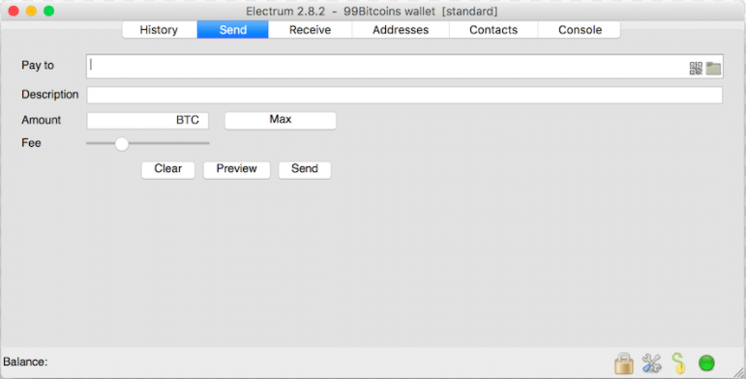
Wallet Examples – Desktop
Electrum
Notes:
You keep the private key in an encrypted file… locally or on removalable media
You should it encrypt all private keys.

Slide 15
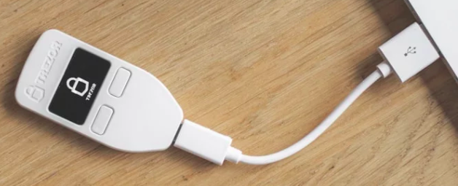
Wallet Examples – Hardware
Trezor
Notes:
The private key stays on the hardware device and transactions are sent to the device, signed on the device, and then sent back to the program to broadcast to the network.

Slide 16
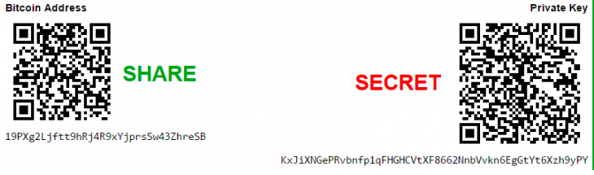
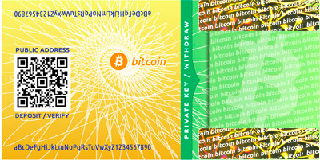
Wallet Examples – Paper
Coindesk
bitcoinpaperwallet
Notes:
The actual key is written out, or encoded into a QR code

Slide 17

Wallet Examples – Metal
Cryptosteel
Notes:
A mnemonic phrase used to generate the private key, or the private key itself, can be stored on metal if you don’t feel safe with a the other forms

Slide 18
Different Protects for Different Threats
Criteria for determining solution:
AMOUNT: How much are you trying to protect?
USAGE: How frequently do you need to transact?
DAMAGE: How severe are the consequences if lost?
PROFILE: Who are you trying to protect it from? What do they know about you?
Baselines for everyone
Multi-Factor Authentication (MFA)
Strong Passwords/Password Managers
Updated systems
Encryption
Notes:
Open Excel Document
https://twofactorauth.org/
https://authy.com/
https://en.wikipedia.org/wiki/Google_Authenticator
https://medium.com/revissolutions/an-introduction-to-google-advanced-protection-90de57d61fc0

Slide 19
Cold vs Hot Storage
Online
Managed Wallets
Web Wallets
Offline that goes Online
Offline that never goes online

Slide 20
Casual (e.g. Managed Wallets)
MFA
Locked down email
Awareness of phishing attacks
Monitor logs if possible
Notes:
E.g. coinbase

Slide 21
Larger amounts
Cold storage
Hardware
Paper
Mind
Multi-sig
Air gapped
Multi-sig air gapped
Notes:
(not endorsements)
Hot examples:
Coin.space (online)
BitGo (online)
Electrum (on an internet connected system)
Cold examples
Trezor hardware
Ledger hardware
Encrypted USB with private key file
Cold storage that never becomes hot (or “warm”)
Air gapped system running Electrum
Transactions are signed offline on air gapped system
Can use hardware signing for increased security
Can add multi-signature for added security
docs.electrum.org/en/latest/multisig.html

Slide 22
Questions. Thank You?
@revissolution
@isaiahsarju
https://www.revissolutions.com
Follow our blog on Medium!
Notes:
https://medium.com/revissolutions
https://twitter.com/revissolution
https://twitter.com/isaiahsarju
https://www.revissolutions.com
https://bitcoin.org/en/choose-your-wallet

